Slide 1
NUTRETO.AI
S M A R T N U T R I T I O N I S T

Slide 2
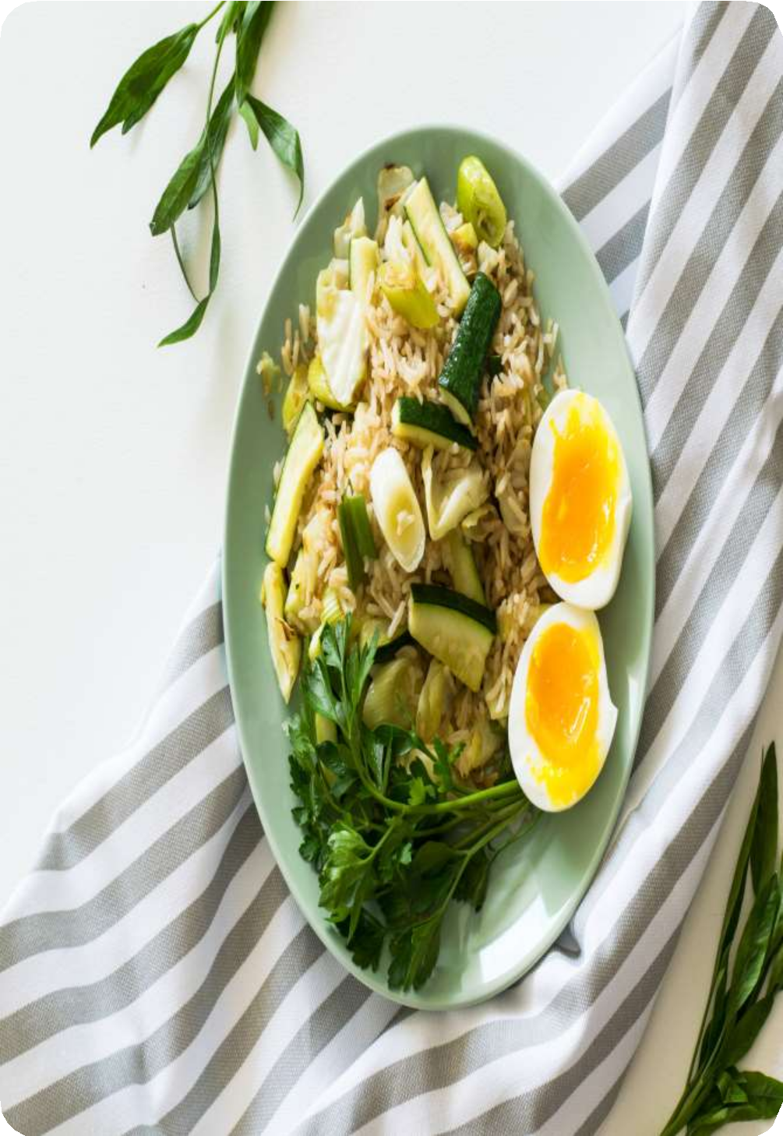
PROBLEM STATEMENT
Accurate dietary management is a growing concern as individuals increasingly seek tools to monitor their nutrition and make healthier choices.
However, most existing dietary applications depend heavily on manual data entry or static databases, which are often inefficient and prone to inaccuracies.
Users struggle to correctly estimate portion sizes, identify
diverse food items, and obtain detailed nutritional insights in real time.
These limitations reduce the effectiveness and practicality
of current systems. Therefore, there is a pressing need for an AI-powered solution that automates nutritional tracking, enhances accuracy, improves accessibility, and provides personalized dietary recommendations.

Slide 3
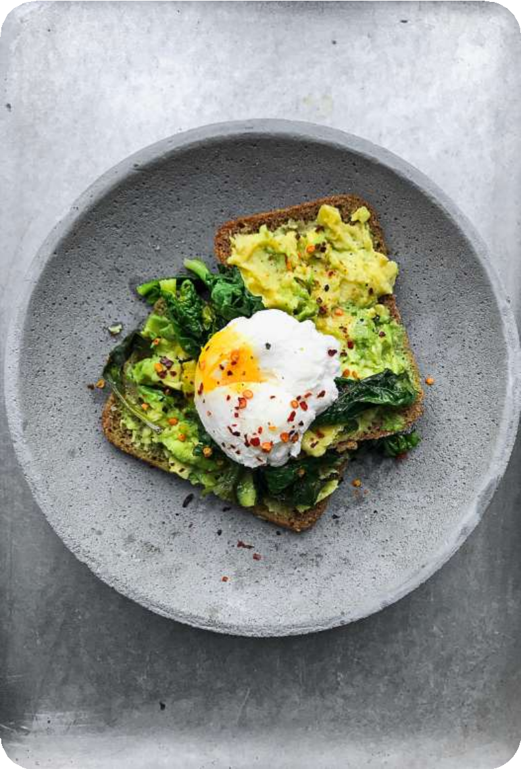
PROPOSED SOLUTION
Nutreto.ai offers an AI-powered solution to overcome the limitations of traditional dietary management tools.
By integrating computer vision and natural language processing,
the application can analyze images of food items to provide real- time nutritional information, including calorie count and macronutrient breakdown.
The Calmate module enables accurate food recognition, while the Dishify module generates customizable recipes with ingredient scaling based on serving sizes.
Additionally, Google Text-to-Speech (GTTS) integration ensures
accessibility by delivering results audibly. Built on
Python, OpenCV, Streamlit, and SQLite, the system adopts an Agile
SDLC approach to ensure iterative improvements, user feedback integration, and continuous performance enhancement.

Slide 4
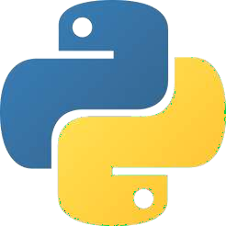






TECH STACK
A natural language processing API that enhances conversational responses, enabling intelligent, context-aware communication between users and the application.
A lightweight Python library that converts text into natural-sounding speech, providing auditory accessibility for visually impaired or convenience-focused users.
An open-source Python framework for building interactive, data-driven web applications with minimal effort, offering real-time updates and responsive interfaces.
A lightweight, serverless, and self-contained database engine widely used for embedding in applications to store, manage, and query structured data.
A versatile, high-level programming language widely used for artificial intelligence, machine learning, data processing, and building scalable applications
An open-source computer vision library enabling real-time image processing, object detection, and classification using advanced algorithms and machine learning.
A framework designed to build applications powered by large language models, enabling contextual understanding and conversational AI interactions effectively.

Slide 5
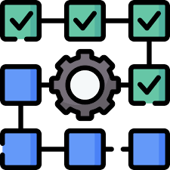



TESTING TECH
Unit Testing: Each module, including food recognition, recipe generation, and text-to- speech, was tested in isolation to verify correct functionality. This ensured individual components performed reliably, handled edge cases effectively, and produced accurate outputs without unexpected errors or breakdowns.
System Testing: A complete evaluation of the entire application was conducted under real-world conditions. This testing validated performance, scalability, accuracy, and user workflows, ensuring the platform delivered a cohesive, reliable, and efficient dietary management experience.
Integration Testing: Testing verified smooth interaction between modules, such as Calmate’s nutritional outputs feeding correctly into the TTS module. It confirmed that Dishify recipes integrated seamlessly with the database, ensuring data consistency and functional harmony across all interconnected system components.
User Acceptance Testing: A sample group of users interacted with the application to assess usability, accessibility, and satisfaction. Their feedback guided refinements in the user interface, accessibility features, and recipe accuracy, ensuring the system met real user expectations.

Slide 6
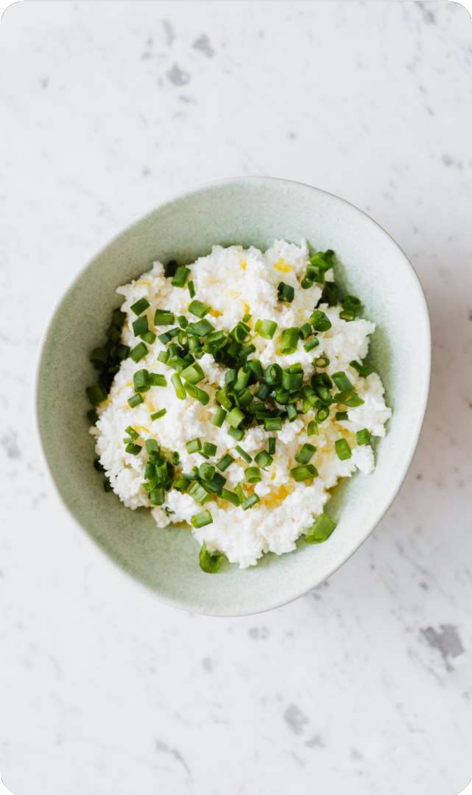
KEY FEATURES
Real-Time Nutritional Analysis
Upload food images to instantly receive calorie counts, macronutrient breakdowns, and essential dietary insights with high accuracy.
Food Recognition with AI
Uses computer vision (OpenCV) to identify food items based on shape, color, and texture, reducing manual input errors.
Customizable Recipe Generation (Dishify)
Generates recipes from either a dish name or uploaded image, with ingredient scaling based on user-defined serving sizes.
Text-to-Speech (TTS) Integration
Provides auditory delivery of nutritional data and recipes through Google Text-to-Speech (GTTS), enhancing accessibility for visually impaired users.
Lightweight Database (SQLite)
Stores nutritional data, recipes, and user feedback securely while ensuring efficient data retrieval and application performance.

Slide 7
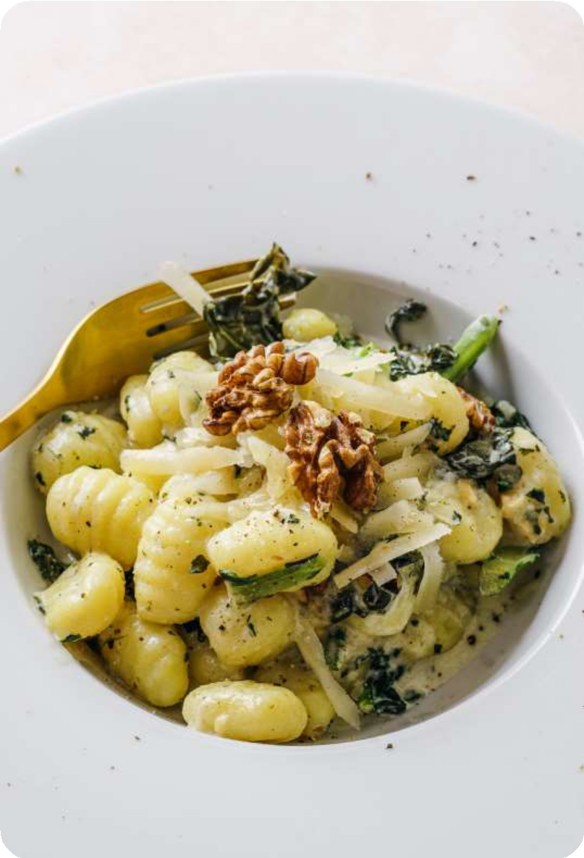
UNIQUE SELLING PROPOSITION
AI-Powered Food Recognition
Nutreto.ai uses advanced computer vision algorithms to identify food items directly from images. This eliminates tedious manual entries, minimizes human error, and provides instant results, making it far more efficient and reliable than traditional dietary management applications.
Real-Time Nutritional Analysis
The system instantly calculates calorie counts, macronutrient breakdowns, and other dietary information. By offering quick and accurate results, Nutreto.ai empowers users to make better food choices on the go, ensuring convenience and reliability in daily nutrition tracking.
Customizable Recipe Generation (Dishify)
Unlike most nutrition apps, Dishify generates personalized recipes from either a dish name or an uploaded image. Users can scale ingredients according to serving size, making it practical for individuals, families, and groups with varied dietary needs.
Accessibility with TTS Integration
Google Text-to-Speech (GTTS) enhances inclusivity by converting nutritional data and recipes into speech. This feature supports visually impaired users and those who prefer auditory interaction, ensuring Nutreto.ai can be used by a diverse and broader audience.

Slide 8
Revenue Projections & Strategy
Your monetization strategy should follow a phased approach:
Phase 1 (Year 1): Freemium launch targeting ₹60 lakhs annual revenue Phase 2 (Year 2): Premium tiers expansion to ₹5 crores annually Phase 3 (Year 3): B2B partnerships driving ₹20 crores revenue
Phase 4-5: International scaling to ₹125+ crores by 2029

Slide 9
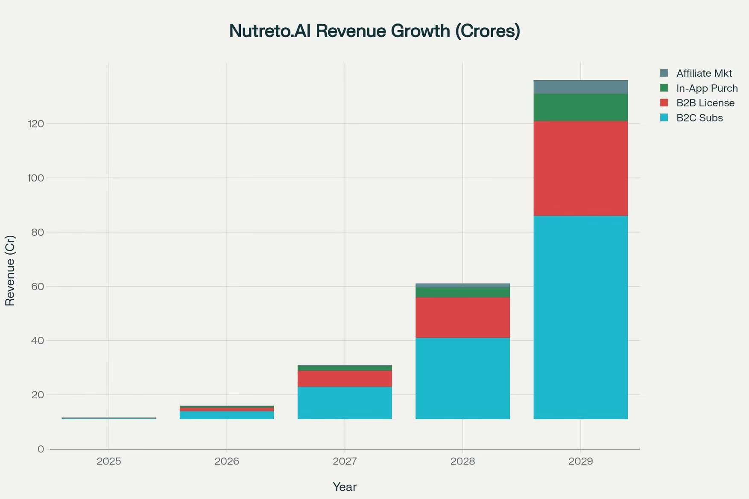

Slide 10
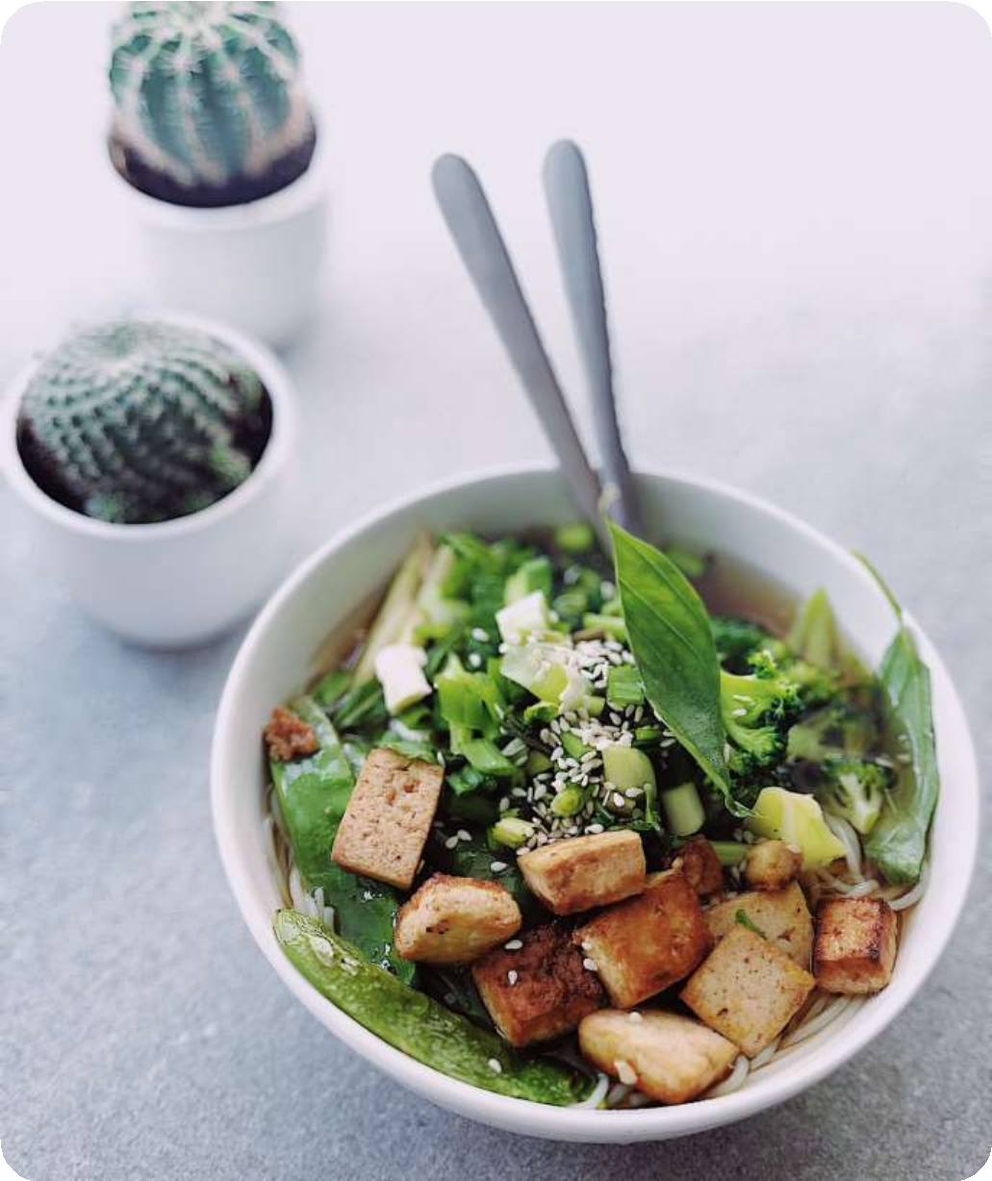
FUTURE SCOPE
Advanced AI Models for Food Recognition
Future versions could integrate deep learning models like CNNs or transfer learning approaches (ResNet, VGG) to improve recognition accuracy. This would allow the app to identify a wider variety of foods, including complex or region-specific dishes.
Personalized Dietary Recommendations
By analyzing user history and preferences, Nutreto.ai could generate personalized meal suggestions using RNNs or LSTMs. This feature would help users achieve specific health goals, such as weight management, muscle gain, or balanced nutrition, tailored to individual needs.
Expanded Food and Recipe Database
The system could broaden its database to include diverse global cuisines, dietary preferences (vegan, keto, gluten-free), and authentic regional recipes. This expansion would make the app relevant for a wider international audience with varied nutritional requirements.
Cloud-Based Scalability
Migrating to cloud infrastructure such as AWS or Google Cloud would enhance scalability and reliability. This would allow the system to support a growing user base, ensure secure data handling, and maintain fast, responsive performance.

Slide 11
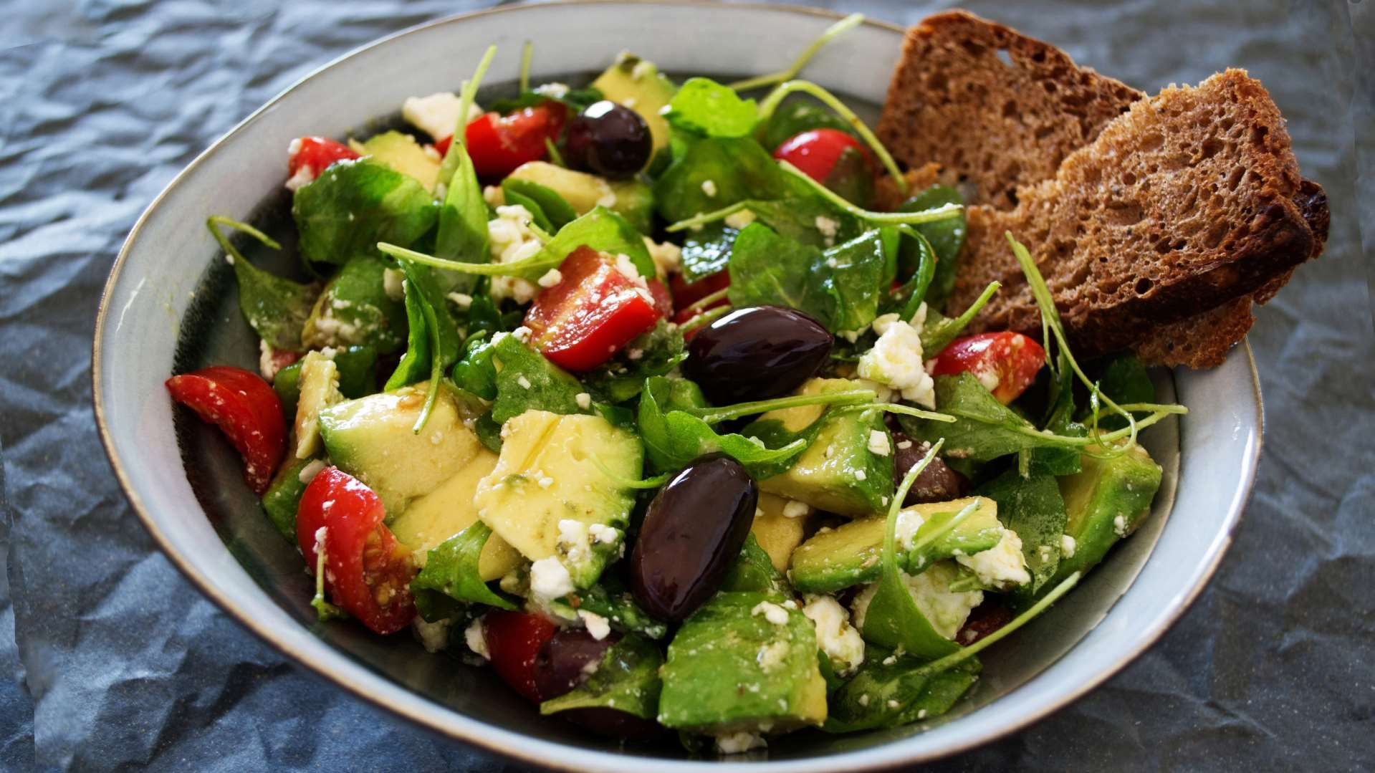


THANK YOU
BY:
UTKARSH JHA(14415602722) DIVYAM SETHI(35815602722)
-

